Slide 1



Collaborative Working &
Best Practice
A Seminar by the Public Services Ombudsman for Wales

Slide 2
Welcome & Introduction
Nick Bennett
Ombudsman

Slide 3
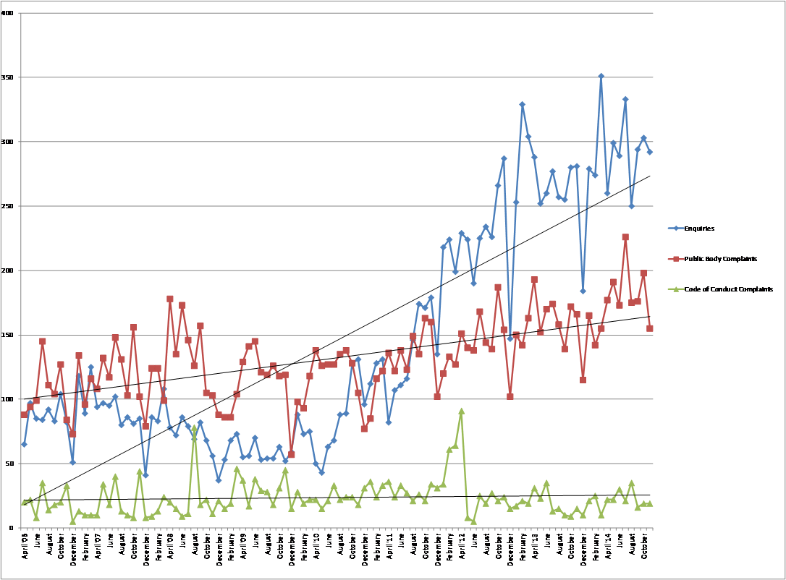
New Workload Trends since 2006/2007

Slide 4
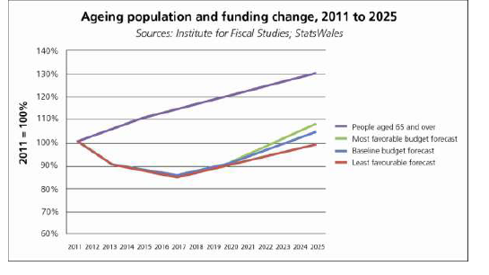
Extract from Report of Commission for Public Service Governance & Delivery: Ageing Population

Slide 5
Enquiries & Complaints Projections to March 2018

Slide 6
Principles of Good Administration & Good Records Management
Consultation Launch
Susan Hudson
PSOW Policy & Communications Manager

Slide 7
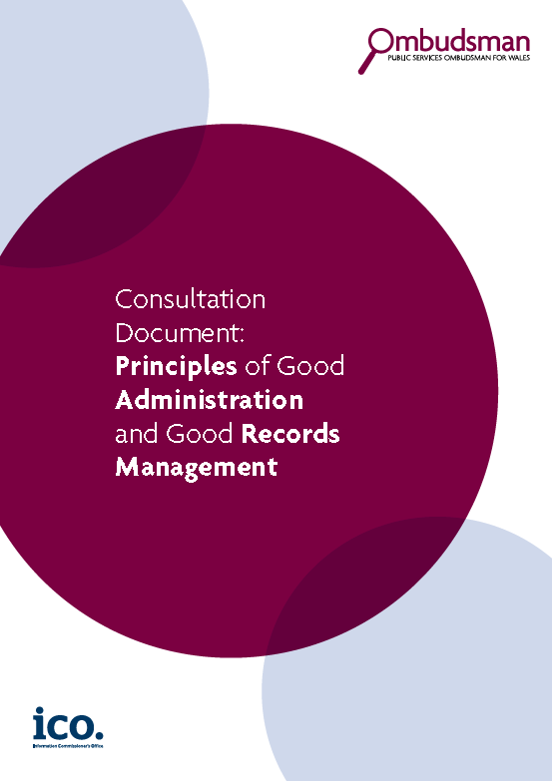

Principles of Good Administration & Good Records Management: Consultation
Principles of Good Administration originally published in 2008
Review conducted in conjunction with the Information Commissioner
Now 8 Principles – 6 original; 2 new
Now includes examples from casework

Slide 8
6 Original Principles:
Principle 1: Getting it right
Principle 2: Being customer focused
Principle 3: Being open and accountable
Principle 4: Acting fairly and proportionately
Principle 5: Putting things right
Principle 6: Seeking continuous improvement

Slide 9
2 New Principles:
Principle 7: Creating good quality records
Principle 8: Managing records effectively

Slide 10
Consultation:
Via representative bodies
Consultation closes 29 April 2015
Document available on website:
www.ombudsman-wales.org.uk
(on ‘For Service Providers’ page)

Slide 11
Principles of Good Administration & Good Records Management
Anne Jones
Assistant Information Commissioner

Slide 12
Principles of Good Administration – Consultation Launch:
The ICO perspective
Christopher Graham - Information Commissioner
Anne Jones - Assistant Information Commissioner

Slide 13
In brief:
1. “What’s that man for?”
2. Specifics and synergies

Slide 14
1. “What’s that man for?”
2. Specifics and synergies

Slide 15
The ICO’s role
UK independent supervisory body reporting directly to Parliament
One office, four locations
Oversees and regulates the Data Protection and Freedom of Information Acts (plus associated legislation)
What we do:
  Advice and guidance for public and organisations
  Complaints handling
  Enforcement action

Slide 16
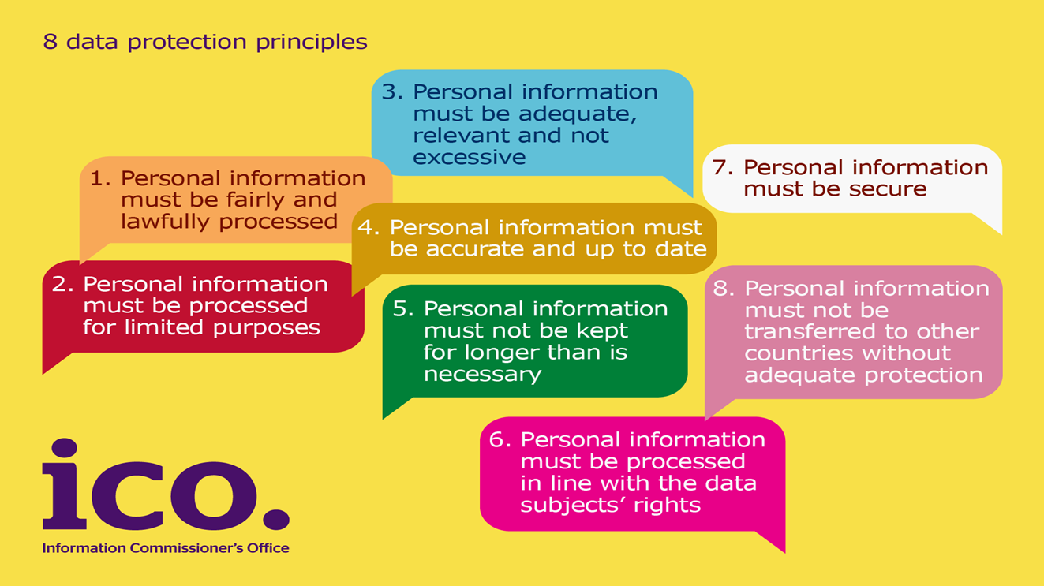
The (other!) eight principles
What the DPA is all about:

Slide 17
Key current issues for the ICO
New EU Regulation for data protection
Privacy seals
Internet of things
Nuisance marketing calls and texts
Google judgment
Personal information online
Big data / open data

Slide 18
Ten years of the FOI Act
The case that showed the public their right to know how money is spent on senior public servants
The case that showed that sunlight really is the best disinfectant
The case that showed that FOIA continues to have an every day benefit for consumers
The case that showed the link to Open Data

Slide 19
1. “What’s that man for?”
2. Specifics and synergies

Slide 20
The “Principles” document: synergies and shared agendas
Benefits of collaborative working
Customer focus: putting the individual at the centre
Being open and accountable: the essence of the FOIA
Effective records management – key from the ICO’s perspective because the DPA and FOIA are all about recorded data
Notes:
)

Slide 21
Two new Principles:
Principle 7: Creating Good Quality Records
Principle 8: Managing Records Effectively

Slide 22
Why is good records management so important?
Underpins and facilitates good practice in all areas
Aids legal compliance
Risk of reputational damage and loss of trust when things go wrong
Risk of enforcement action from the ICO

Slide 23
How not to do it: some examples
Dept of Justice(NI): Fined £185,000. Cabinet containing information relating to terrorist activity sold at auction.
Stockport Primary Care Trust: Fined £100,000 following the discovery of a large number of patient records at a site formerly owned by the Trust.
Cardiff City Council: Undertaking, requiring measures in place to ensure greater compliance with subject access requests.

Slide 24
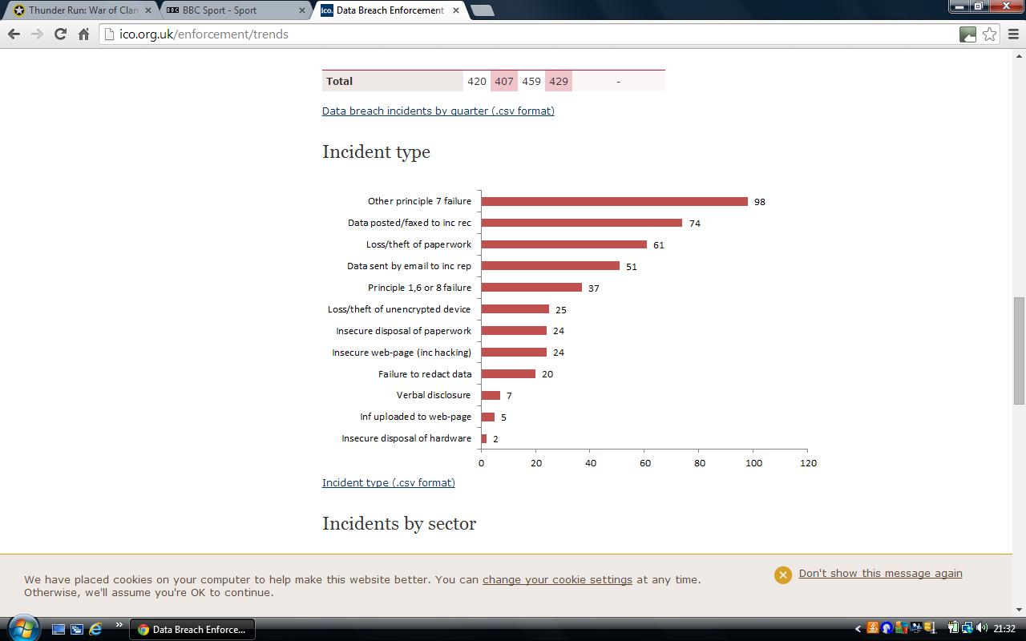
Security incidents July – Sept 2014

Slide 25
Good Practice at the ICO
Role of the ICO’s Good Practice department:
  Audits and advisory visits
  Good practice workshops
  Self assessment tools
  Sectoral “Outcomes” reports
    Include examples of good and bad practice in administration and records management

Slide 26
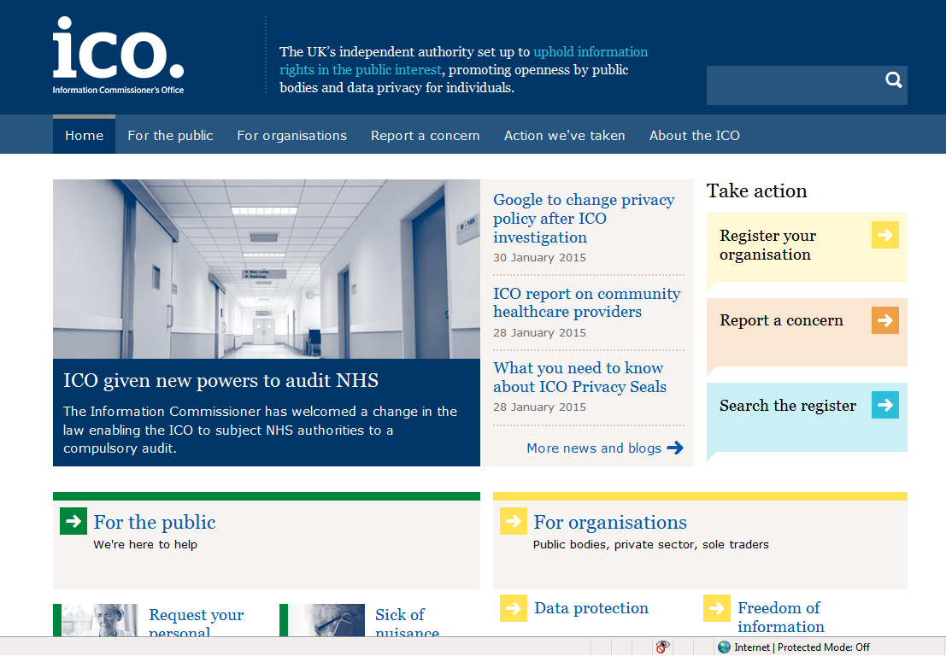
www.ico.org.uk

Slide 27



Contact us:
Information Commissioner’s Office (Wales)
2nd Floor
Churchill House
Churchill Way
Cardiff CF10 2HH
Tel: 029 2067 8400
wales@ico.org.uk
Subscribe to our e-newsletter at www.ico.org.uk, or find us on:
www.twitter.com/iconews

Slide 28
Complaints Handling
Chris Vinestock
Chief Operating Officer &
Director of Investigations

Slide 29
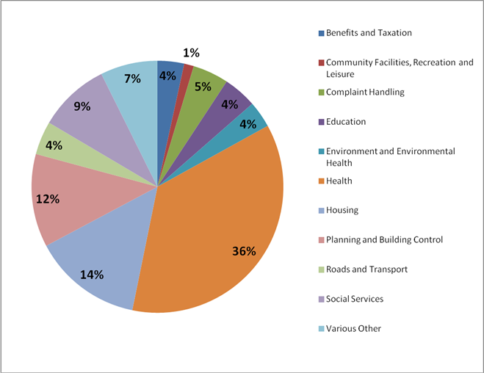
Complaints by Subject

Slide 30
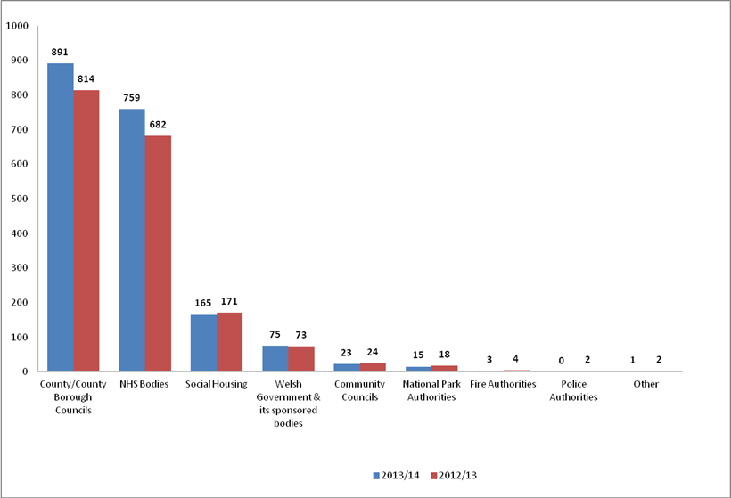
Complaints by Sector

Slide 31
Stakeholder Engagement
Compliance
New PSOW Legislation
Nick Bennett

Slide 32
New PSOW Legislation
Own Initiative Investigations
Accept Oral Complaints
Complaints Standards Authority
Private Healthcare
Stakeholder Engagement

Slide 33
And Finally ...
Thank you for your time today

